Slide 1
SYBSc Semester IV
US04AENG21
TOPIC 3
FUNCTIONS of ENGLISH

Slide 2
Language Is Expressive
Verbal communication helps us meet various needs through our ability to express ourselves.
In terms of instrumental needs, we use verbal communication
to ask questions that provide us with specific information.
to describe things, people, and ideas.
inform, persuade, and entertain
to form our personal relationships are formed. At its essence, language is expressive. Verbal expressions help us communicate our observations, thoughts, feelings, and needs (McKay, Davis, & Fanning, 1995).

Slide 3
What utterances make up our daily verbal communication?
Some of our words convey meaning, some convey emotions, and some actually produce actions. Language also provides endless opportunities for fun because of its limitless, sometimes nonsensical, and always changing nature.
In this section, we will learn about the five functions of language, which show us that language is expressive, language is powerful, language is fun, language is dynamic, and language is relational.

Slide 4
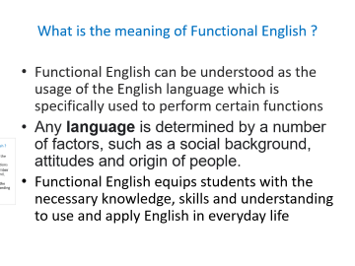

What is the meaning of Functional English ?
Functional English can be understood as the usage of the English language which is specifically used to perform certain functions
Any language is determined by a number of factors, such as a social background, attitudes and origin of people.
Functional English equips students with the necessary knowledge, skills and understanding to use and apply English in everyday life

Slide 5
The table below contains sets of exponents A-D. Each of them conveys one function of students’ language. Which function is conveyed by each set?
A How about starting with number five? Let’s do this together. Why don’t we ask one for the other groups? | B Can you give an example for number 4? Can I use this word to talk about myself? Does this mean the same thing?
C It’s great to see you again. How are you? Good morning. | D My answer’s the same as yours. Yes, that’s right. That’s my opinion, too.

Slide 6
Given below are examples of student language. There are eight. Which function does each of the examples show?
Hi!
Could you say that again, please?
I haven’t got the same answer.
See you later.
Is it page 10 or page 50?
Well, I guess this is the best answer.
Yes, I agree with you.
What do you say?

Slide 7
Functional Language
"Functional language" is language that we use to perform various "functions" such as giving advice or apologizing.
Functional language typically uses fixed expressions for each function–for example "if I were you" or "my suggestion is" in giving advice, and "it was my fault" or "please forgive me" in apologizing.
These pages list common expressions for each function, graded by level.

Slide 8
Giving Advice
if I were you, my suggestion is...
Making Requests
can I, may I ask, I'd like to request...
Apologizing
it was my fault, please forgive me...
Giving Bad News
I'm sorry to say, I tried my best but...
Agreeing
you're right, I feel the same way...
Disagreeing
I don't really agree, but what about...
Disagreeing Strongly
absolutely not, rubbish! I can't accept it...
Offering
shall I, can I give you a hand...
Asking for Opinions
in your opinion, what's your view on...
Giving Opinions
I feel that, I could be wrong but...

Slide 9
Introducing yourself
My name is ...
I'm ....
Nice to meet you; I'm ...
Pleased to meet you; I'm ...
Let me introduce myself; I'm ...
I'd like to introduce myself; I'm

Slide 10
GREETINGS
Hi, hello. Good morning, good afternoon, good evening. How are you? How are you doing? How do you do? | Hi, hello. Good morning/Good afternoon/Good evening. I'm fine thank you (thanks)/Okay! Thank you (thanks)/Can't complain/Not bad. How about you?/And you? How do you do?

Slide 11
Introducing others:
Ram, please meet Ashok
Ram, have you met Ashok?
I'd like you to meet Ashok, my brother/friend
I'd like to introduce you to Jayesh.
Sita, this is Gita. Gita, this is Sita.

Slide 12
Useful responses when introducing yourself or other people:
Nice to meet you.
Pleased to meet you.
Happy to meet you.
How do you do?

Slide 13
Talking about ability
I can't help you. I am busy.
I'm unable to help you.
When I was young I was able to earn my living pretty well; I could work hard. Now I can't. I'm too old.
I can stand on my head for five minutes.
Can you speak Arabic?
Yes, I can.

Slide 14
Ability
In the past
Express ability in the past as follows
I was unable to visit him.
I couldn't eat at all when I was ill.
In the future
Express ability in the future as follows
I will be able to buy a house when I get a good job.
The teacher can assist you after class if you have any questions

Slide 15
Asking For & Giving Permission
When you ask for permission to use something that belongs to someone else you have to do your best to be polite. It is desirable to use the word "please."
Can I go out, please?
May I open the window, please?
Please, can I have a look at your photo album?
Please, may I taste that hot spicy dish?
Do you mind if I used your PC?
Would you mind if I asked you something?
Is it okay if I sit here?
Would it be all right if I borrowed your mobile Phone?

Slide 16
Giving Permission:
Yes, please do.
Sure, go ahead.
Sure.
No problem.
Please feel free to use the computer.
Refusing to give permission:
No, please don’t.
I’m sorry, but that’s not possible.
I'm afraid, but you can't.

Slide 17
Making Offers
How to make offers in English?
It is common that English speakers make offers in conversations in order to be polite and helpful. When they do so they use these expressions:
"Can I help you?"
"Shall I open the window for you?"
"Would you like another cup of coffee?"
"Would you like me to clean the board?"
"How about a juice? "

Slide 18
Responding to offers
Accepting
Yes please. I'd like to.
That would be very kind of you.
Yes please, that would be lovely.
Yes please, I'd love to.
If you wouldn't mind.
If you could.
Thank you, that would be great
Declining
It's OK, I can do it myself.
Don't worry, I'll do it.
No, thanks
No, thank you

Slide 19
Inviting:
Do you want to go to the movies tonight?
Would you like to go to the theater tomorrow?
Would you be interested in going to the stadium next Sunday?
How do you fancy going to the restaurant for dinner?
How about going to the movies?
Care to come over for lunch?
I was just wondering if you would like to come over for a coffee.
We'd be delighted to have you over for my birthday party.

Slide 20
Declining invitations:
I can't. I have to work.
This evening is no good. I have an appointment.
I'm busy tomorrow. Can I take a rain check* on that?
That's very kind of you, but actually I'm doing something else this afternoon.
Well, I'd love to, but I'm already going out to the restaurant.
I'm really sorry, but I've got

Slide 21
Talking about likes and dislikes
Expressing likes:
I like…
I love...
I adore…
I ‘m crazy about…
I’m mad about…
I enjoy…
I’m keen on…

Slide 22
Expressing dislikes:
I don’t like…
I dislike...
I hate…
I abhor…
I can’t bear...
I can’t stand…
I detest...
I loathe...

Slide 23
Asking for and Giving advice
Asking for advice:
I've got a bad toothache. What do you suggest?
What do you advise me to do?
What should I do?
What ought I to do?
What's your advice?
If you were me what would you do?

Slide 24
I think you should……
You ought to….
If I were in your place, I would….
You must definitely……

Slide 25
I have a complaint to make. | Your pizza is just too salty.
I'm sorry to say this but | your food is inedible.
I'm afraid I've got a complaint about your child. He's too noisy . 2. I'm afraid there is a slight problem with the service in this hotel. 3.Excuse me but you are standing on my foot. 4. I want to complain about the noise you are making. 5. I'm angry about the way you treat me. I don’t like the way you treat me.

Slide 26
Giving advice
If I were you, I would go to the dentist.
Why don't you go to the dentist?
You'd better brush your teeth regularly.
You ought to/should avoid eating sweets.
If you take my advice, you'll go to the dentist.
It might be a good idea to brush your teeth on a regular basis.
I advise you to brush your teeth on a regular basis.
Have you thought about seeing a dentist

Slide 27
Declining to give advice
I don't know what to advise, I'm afraid.
I wish I could suggest something, but I can't.
I wish I could help.
I'm afraid I can't really help you.

Slide 28
Suggestions
.
The following English phrases and expressions are all used to make suggestions and give advice to people.
Suggestions | Response
Let’s revise our lessons. What about going to the cinema tonight? How about playing cards? Why don't we do our homework? Couldn't we invite your grandmother to our party? Shall we have a walk along the river? What would you say to a cup of coffee? Don't you think it is a good idea to watch TV? Does it matter if we use your car? | Ok. Yes, let's. Yes, I'd like to. Yes, I'd love to. What a good idea! Why not? Yes, with pleasure. Yes, I feel like taking a walk

Slide 29
Refusing suggestions:
No, let's not.
No, I'd rather not.
I don't feel like it.
I dislike going for a walk.
What an awful / bad idea!

Slide 30
Expressing your Opinion
I think...
As far as I'm concerned,..
To my mind,...
According to me,...
As I see it, ...
It seems to me that...
In my point of view / my opinion,....
From my point of view...
I am of the opinion that...
I take the view that. ..
My personal view is that...
In my experience...
As far as I understand / can see/see it,...

Slide 31
Agreeing with an opinion:
I agree with this opinion.
I completely agree with this view.
This is absolutely right.
I couldn't / can't agree more.
Partial agreement:
I agree with this point of view, but...
This idea is right, but...
I agree with you, but...
Disagreeing with an opinion:
I'm afraid. I can't agree with you.
I disagree with you.
I don't agree with you.
I'm not sure I agree with you
I think you're wrong

Slide 32
Apologizing
Making apologies: I do apologize for... I must apologize for... I apologize for... I'd like to apologize for... I am so sorry for... I shouldn't have... It's all my fault. I'm ashamed of... Please, forgive me for... Excuse me for ... I'm terribly sorry for... Pardon me for this... Please, forgive me for my.... Please, accept my apologies for... | Accepting apologies: That's all right. Never mind. Don't apologize. It doesn't matter. Don't worry about it. Don't mention it. That's OK. I quite understand. You couldn't help it. Forget about it. Don't worry about it. No harm done

Slide 33
Making and responding to a request
It's important to be polite when you ask for something.
Can you show me your photo album, please? Will you lend me your book, please? Could you possibly show me the way to the post office, please? Would you help me with this exercise, please? Would you mind lending me your pen, please? | Sure here you are. Okay. No, I'm sorry I need it I'm afraid I can't.

Slide 34
Asking about and giving directions
Asking for | Giving directions
To ask about directions use these questions: How can I get to . . . from here? How can I get to . . . ? Can you show me the way to...? Can you tell me how to get to . . . ? Where is . . . ? What's the best way to get to . . | Go straight on Turn left/right Take the first (turning) to the left/right. Go past the restaurant/school... The ... is beside/in front of/next to...the....

Slide 35
ASKING FOR INFORMATION
Place— Where do you live/ work/study?
Time— When do you go to college?/ When does he get up?
Manner— How does she go to college?( By bus)
Identity— Who is in the garden?
Choice— Which book did you buy?
Reason— Why are you late?
Distance— How far is the station from here?
Number— How many friends are coming to the party?
Quantity— How much water do you need?
J) General information- What is your name? / What do you do on Sundays?

Slide 36
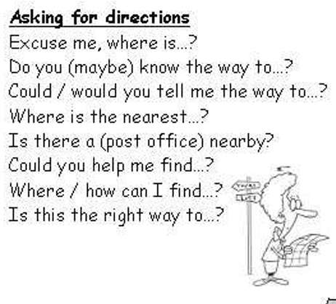

Slide 37
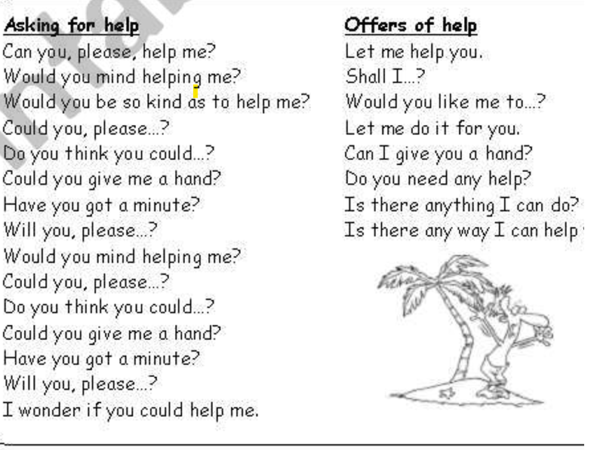

Slide 38
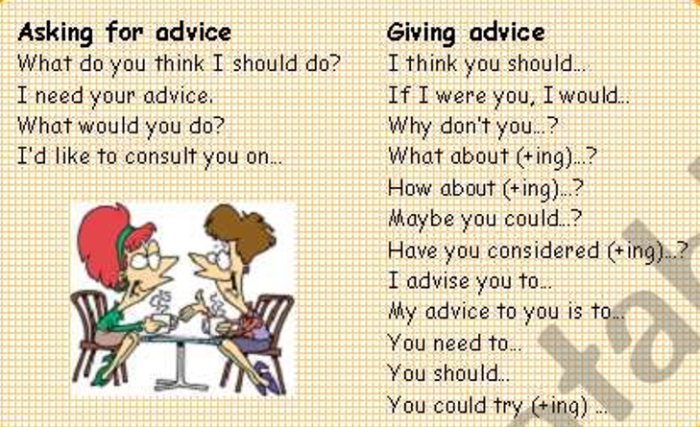

Slide 39
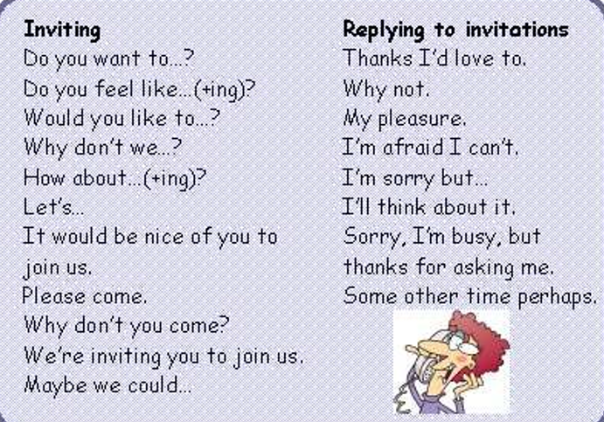

Slide 40
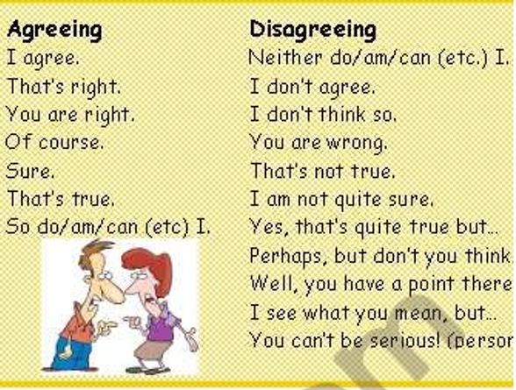

Slide 41
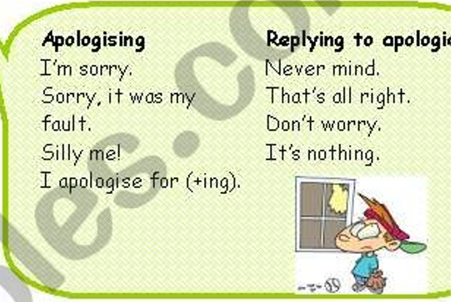

Slide 42
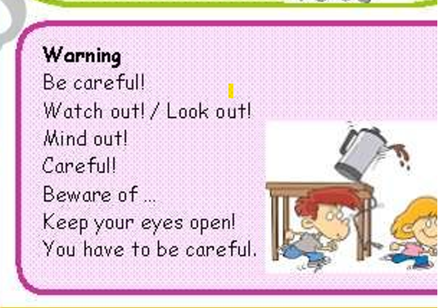

Slide 43
